Slide 1
Front-End Web Development with React

Slide 2
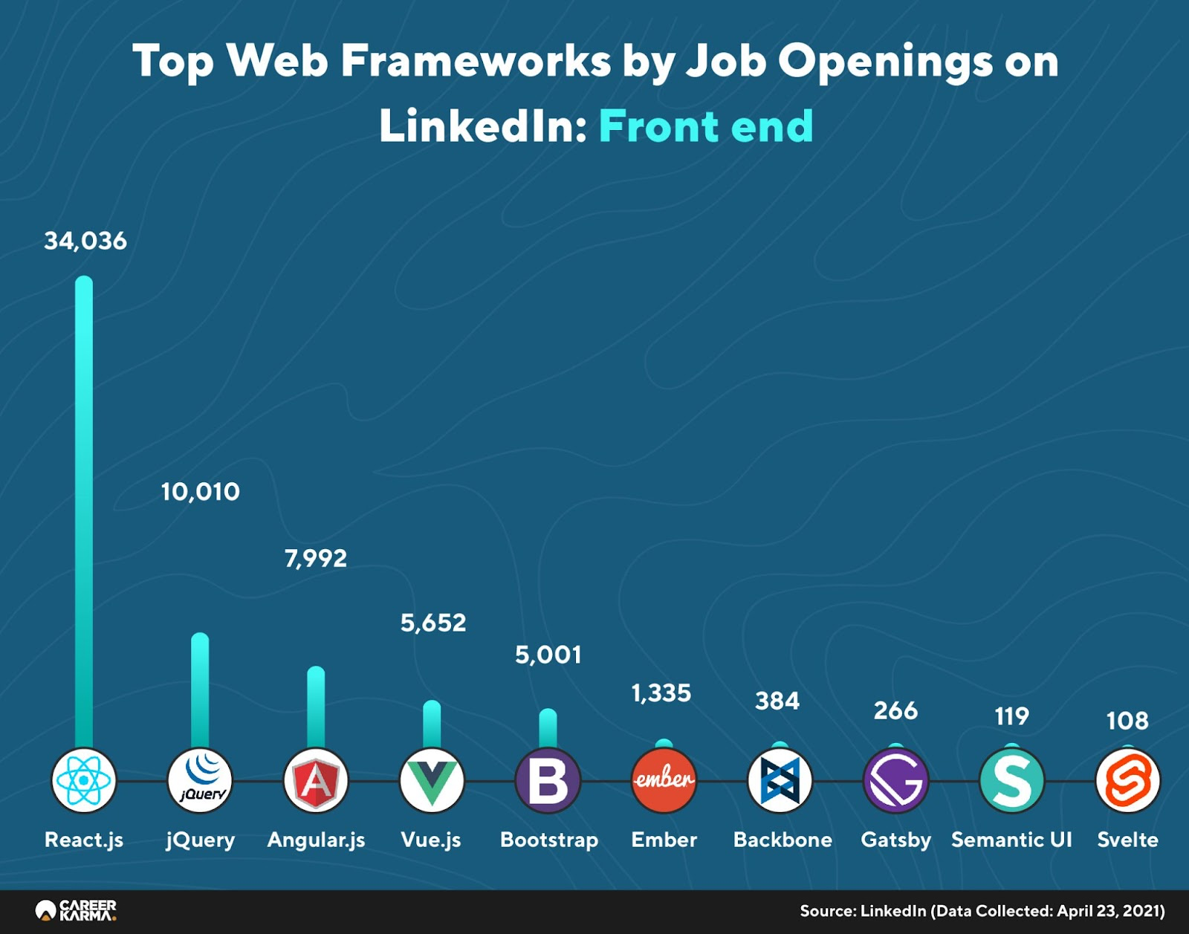
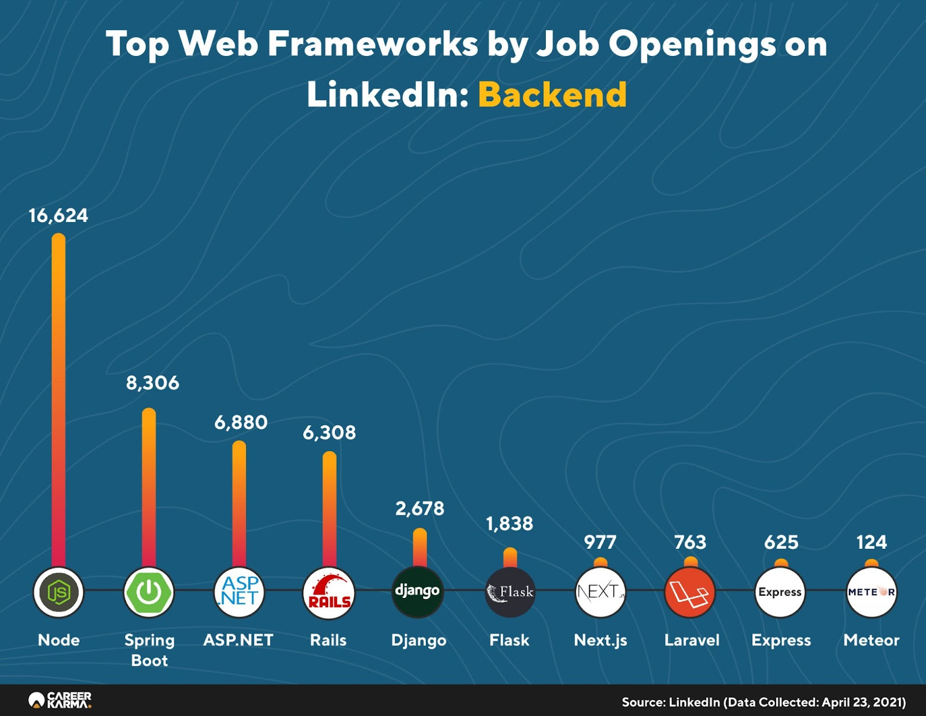
Why should you study this course?
Source: LinkedIn (Data Collected: April 23, 2021)

Slide 3
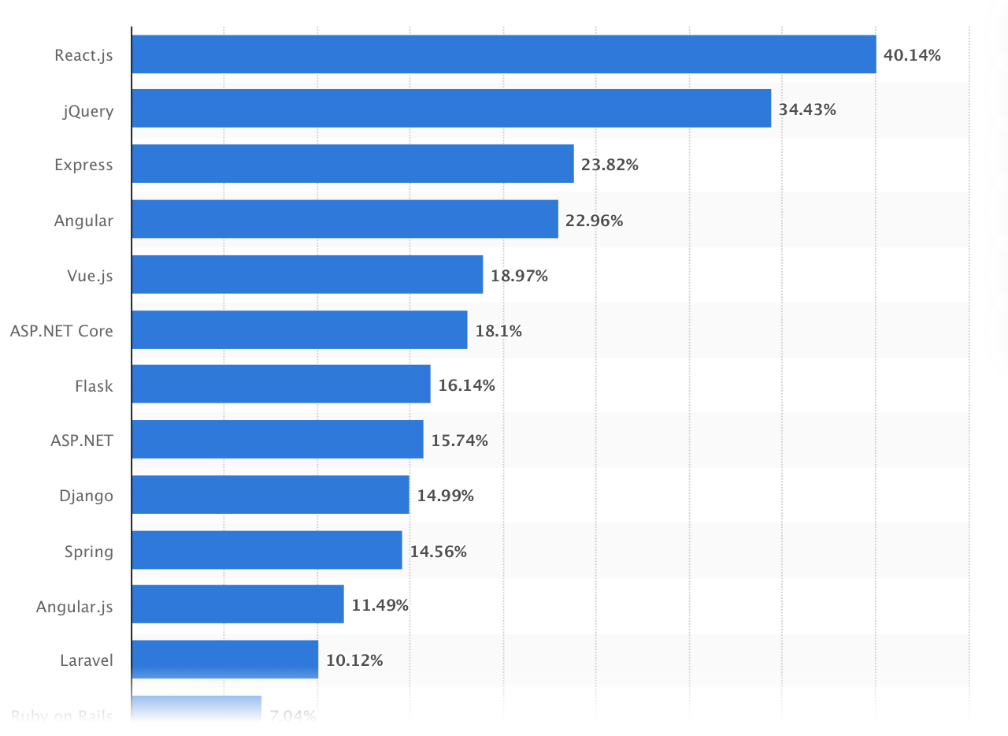
Why should you study this course?
Most used web frameworks among developers worldwide, as of 2021
Source: https://www.statista.com/statistics/1124699/worldwide-developer-survey-most-used-frameworks-web/

Slide 4
Prerequisites
Completed:
WED201c (Web Design for Everybody)

Slide 5
Course Objectives
Set up, design and style web pages using Bootstrap 4 and its components
Building responsive web page design for multi screen size
Using web tools to setup and manage web sites
Developing client-side Javascript application using React library
Using Flux architecture and Redux to develop React-Redux powered applications
Using Fetch for client-server communication and the use of REST API on the server side.

Slide 6
Course Description
Overview of client-side web UI framework
Grids and responsive design
Bootstrap CSS and JavaScript components
CSS preprocessors, Less and Sass
The basics of Node.js and NPM
JavaScript ES6 for developing React application
Reactstrap for Bootstrap based responsive UI design
React components, React router
Flux architecture and Redux
Working with Fetch and REST API for client-server communication

Slide 7
Course Plan
See course plan on flm

Slide 8
Materials/ References
https://getbootstrap.com/docs/4.6/getting-started/introduction
https://reactjs.org/versions
CMS forum

Slide 9
Learning Environments
NodeJS 16.4.1
NPM 7.18.1
Bootstrap 4.6.0
Jquery 3.6.0
Popper.js 1.16.1
React 17.0.2
Visual Studio Code (version 1.59 or later) (https://code.visualstudio.com/Download)
A Notebook for reports of labs and assignments.

Slide 10
Course Rules
How to conduct
Prepare contents of the next session at home
Following lessons in classroom
Completing module assessments in time and Quizzes (via CMS)
Write reports of all labs and assignments to your notebook
Communication
Class
Interchange by FU-HN CMS, Forum
Discussing actively in your team and classroom
Free to question and answer
Others
Off phone, no game, no chat in class
Use laptop under teacher’s instruction

Slide 11
Evaluation Strategy
Must attend more than 80% of contact hours (if not, not allow to take exam).
Evaluating
02 Progress Tests (PT: 15%)
08 Labs (L: 20%)
01 Assignment (AS: 15%)
01 Practical Exam (PE: 20%)
(Practical exam retake only when the score of PE < 4))
Final Exam (FE: 30%)
Final result = 15%(PT) + 20%(L) + 15%(AS) + 20%(PE) + 30% (FE)
Pass:
Every on-going assessment component > 0
Final Exam score >= 4 and
Final result >= 5
Final exam retake only when not passed

Slide 12
How to study
This course is complex knowledge (however, it’s attractive and exciting), so you need to keep a tight grip on it
Read
On the books to get the general concept
Reference, study, collection from anywhere else (internet, your classmate, forum …)
Attend lectures
Listen, understand, then make your notes
Give your explanation about some topic in lectures
Ask questions
Give some examples that do not exist in your book
Practice all the exercises, demo to make your sense
After classes
Discuss your classmate indirectly, on the forum
Analyze, design, and implement labs and assignment. Write reports in your notebook
Build your team in yourselves to support together in studying

Slide 13
Academic policy
Cheating, plagiarism and breach of copyright are serious offenses under this Policy.
Cheating
Cheating during a test or exam is construed as talking, peeking at another student’s paper or any other clandestine method of transmitting information.
Plagiarism
Plagiarism is using the work of others without citing it; that is, holding the work of others out as your own work.
Breach of Copyright
If you photocopy a textbook without the copyright holder's permission, you violate copyright law.

Slide 14
Front-End Web Development with React Course Overview

Slide 15
Expected Background
You should have good working knowledge of:
HTML
CSS
JavaScript

Slide 16
Web Design and Development
Design
User Interface(UI)/User Experience (UX) Design
Visual Design
Prototyping
Colors, Graphics and Animation
Development, Building and Deployment
Web UI Frameworks: Bootstrap 4
JavaScript Frameworks/Libraries: Angular/React
Hybrid Mobile Frameworks: Ionic, Cordova, NativeScript and React Native
Server-side Development: Node + Express + MongoDB

Slide 17
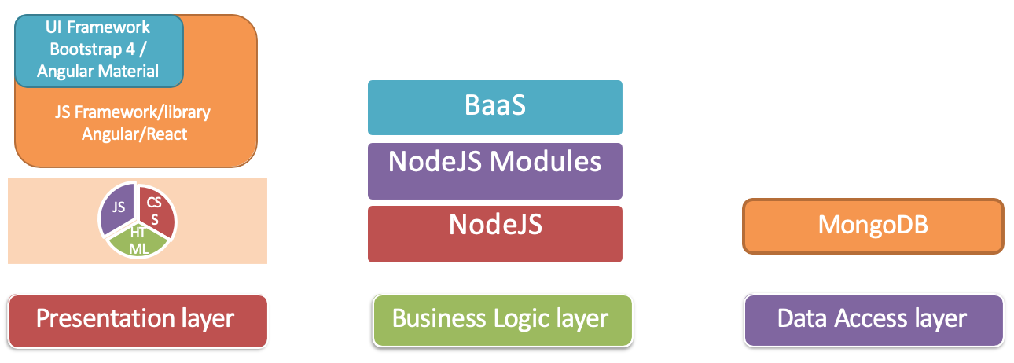
Full Stack Web Development

Slide 18
Course Outline
Bootstrap 4
Responsive Design and Bootstrap Grid System
Bootstrap CSS and JavaScript Components
Web Tools:
Git
Node.js and NPM
React
Reactstrap
Redux
Fetch

Slide 19
Module 1: Bootstrap Overview
Full Stack Web Development: The Big Picture
Setting up Development Environment: Git and Node
Introduction to Bootstrap
Responsive Design and Bootstrap Grid System
Lab 1

Slide 20
Module 2: Bootstrap CSS Components
Navigation and Navigation Bar
User Input: Buttons and Forms
Displaying Content: Tables and Cards
Images and Media: Images, Thumbnails, Media Objects
Alerting Users: Tags, Alerts, Progress Bars
Lab 2

Slide 21
Module 3: Bootstrap JavaScript Components
Bootstrap JavaScript Components Overview
Tabs, Pills and Tabbed Navigation
Hide and Seek: Collapse and Accordion
Revealing Content: Tooltips, Popovers and Modals
Carousel
Lab 3

Slide 22
Module 4: Web Tools
Bootstrap and JQuery
Less is More!: Less and Sass
Building and Deployment: NPM Scripts
Lab 4

Slide 23
Module 5: Introduction to React
Introduction to React
ReactComponents
Lab 5

Slide 24
Module 6: React Router and Single Page Applications
React Component Types
React Router
Single Page Applications
Lab 6

Slide 25
Module 7: React Forms, Flux Architecture and Introduction to Redux
Controlled Forms
Uncontrolled Forms
Introduction to Redux
React Redux Form
Lab 7

Slide 26
Module 8: More Redux and Client-Server Communication
Redux Actions
Redux Thunk
Client-Server Communication
Fetch
React Animations
Building and Deployment
Testing
Lab 8

